Slide 1
Angular Templates - Start to Source

Slide 2
Who is this wacky person?
I work @ Hilton (React)
Worked w/ Angular 2.5 years
Collects retro video games
Loves open source
I'm Corbin Crutchley

Slide 3
What're we going to talk about?
What templates are
How you can utilize them
How Angular uses them internally
What are structural directives
How can we write our own
Things

Slide 4
Ng-template intro
Demo
Templates are a concept in Angular that allow you to group together a set of elements.
`ngIf` will show "True" or "False" based on `bool`
`falseTemp` is a template reference variable
Won't render on screen without explicitly mentioned
Such as an ngIf

Slide 5
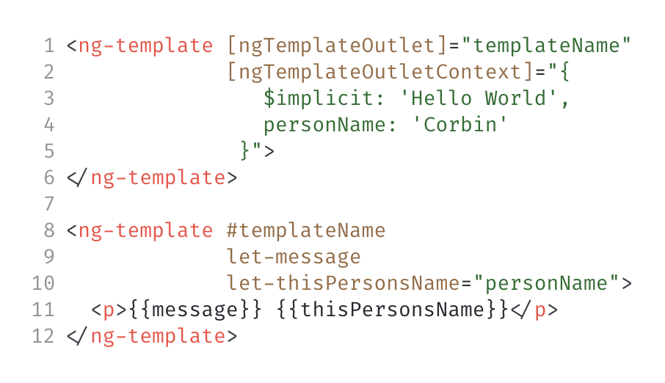
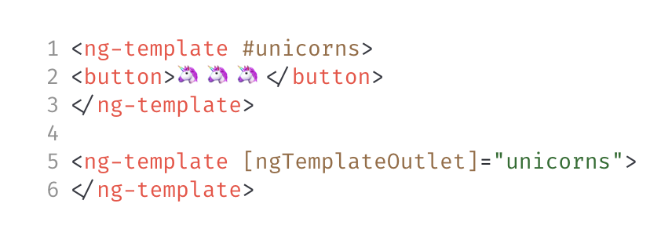
ngTemplateOutlet
Demo
Demo
You're able to render templates without the use of an `ngIf` by using the `ngTemplateOutlet` directive
Context is a way to pass data
Named and default args
`$implicit` is preserved keyword for default binding
Context = normal object
Provided as the input `ngTemplateOutletContext`

Slide 6
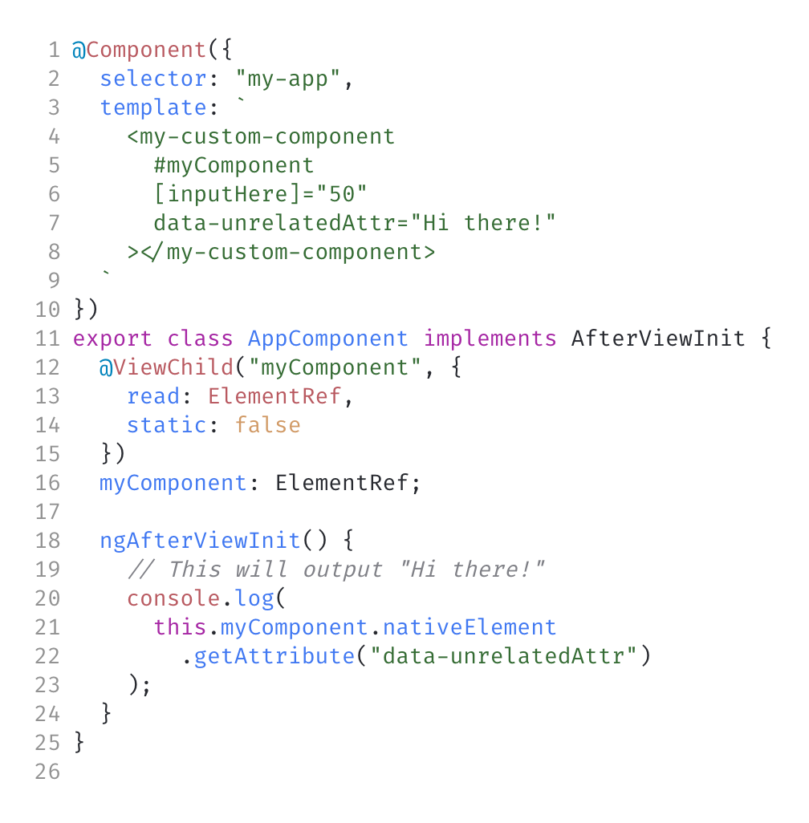
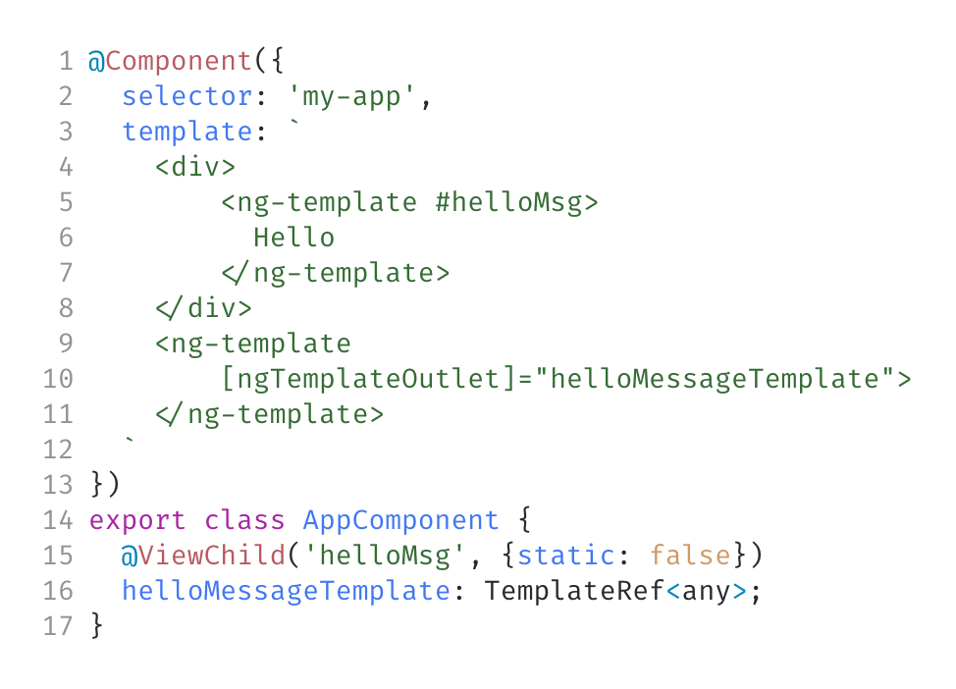
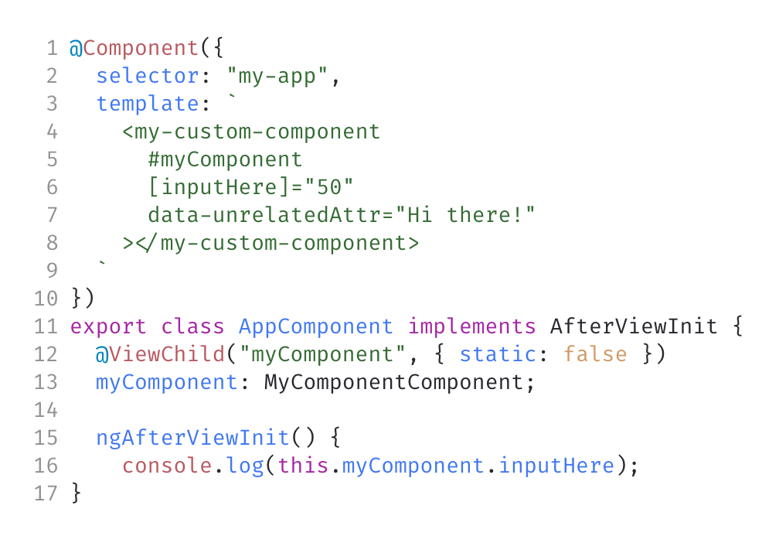
ViewChild
Demo
Demo
Demo
ViewChild is a way to get a reference in the component logic to a template reference variable
Not just for templates!
Can be used to get component props
Angular guesses the type
Guessed type can be overwritten using `read` prop

Slide 7
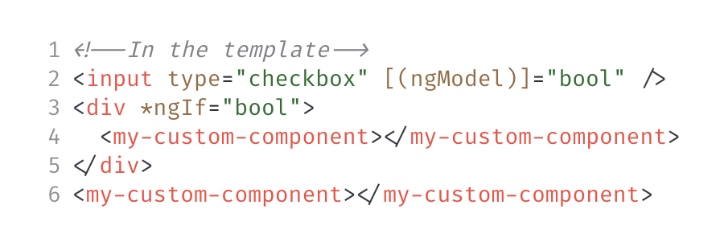
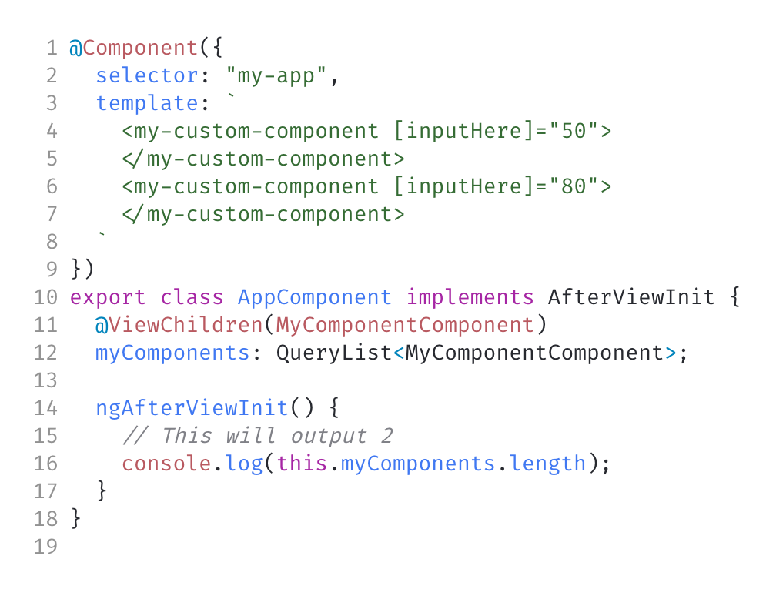
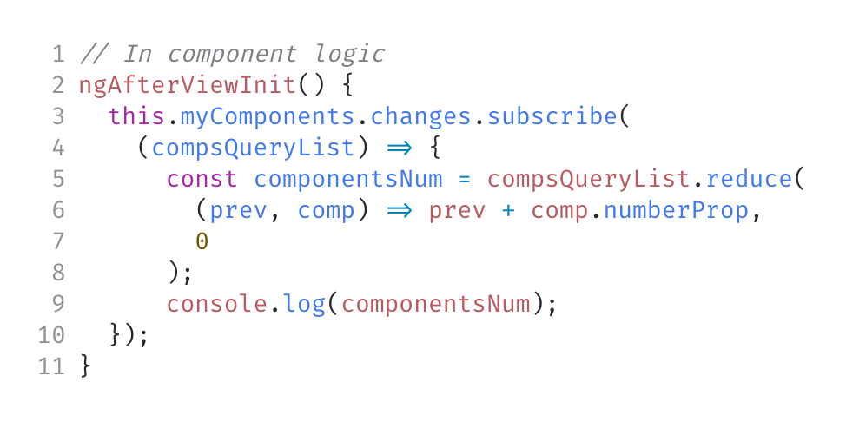
ViewChildren
Demo
Demo
You're able to get a reference to many items in the template at once
Returns a QueryList
Same query options as ViewChild
Will return every item that the query matches
Can run code when this query results change

Slide 8
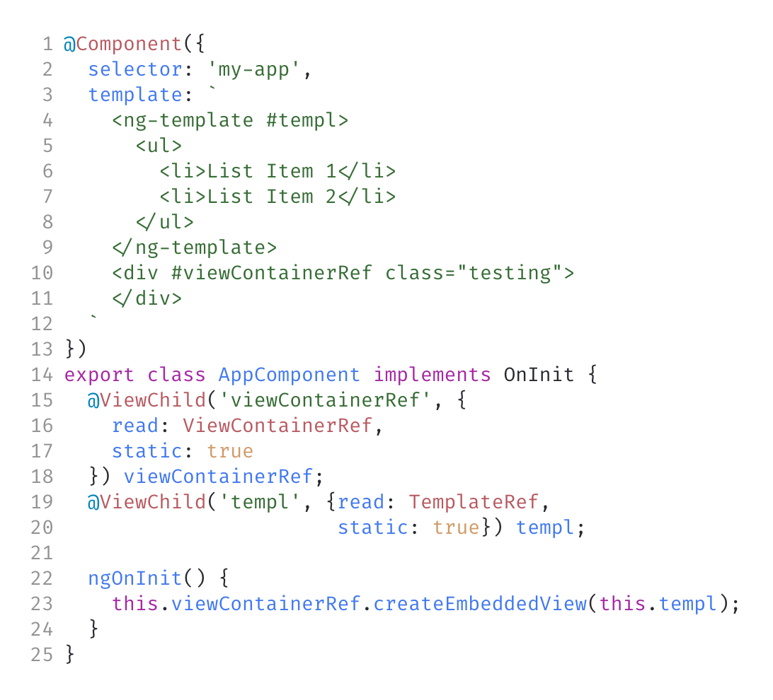
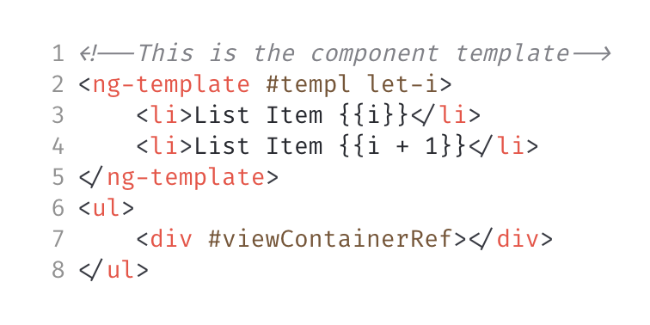
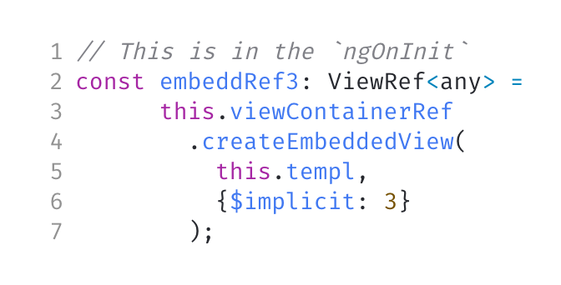
Embed Views from Logic
Demo
Demo
View Containers are what hold collection of "views". When a template is rendered it "embeds" a view into a view Container
Using `ViewContainerRef`, you can create embedded views manually
View Containers are created when requested
Have methods to handle views
createEmbeddedView:
Can handle context
Return a view reference

Slide 9
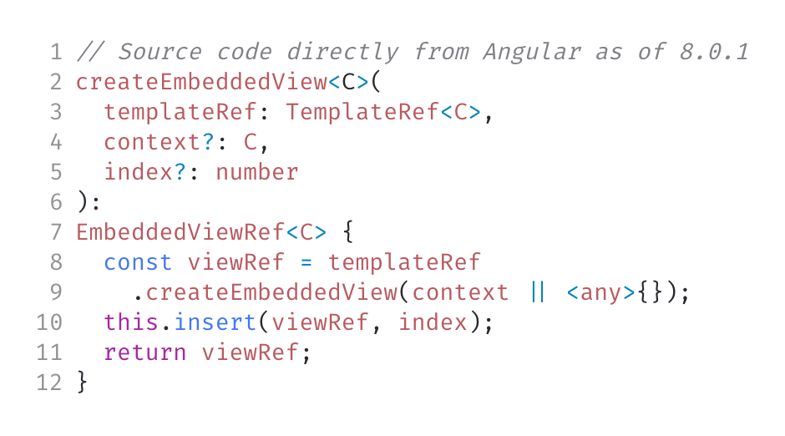
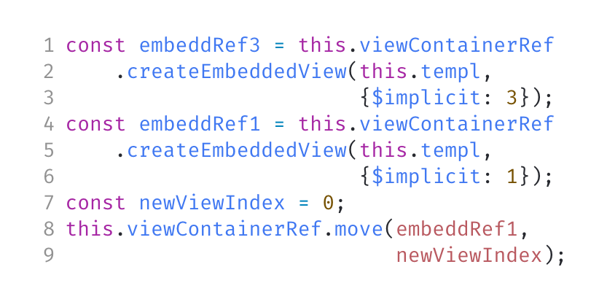
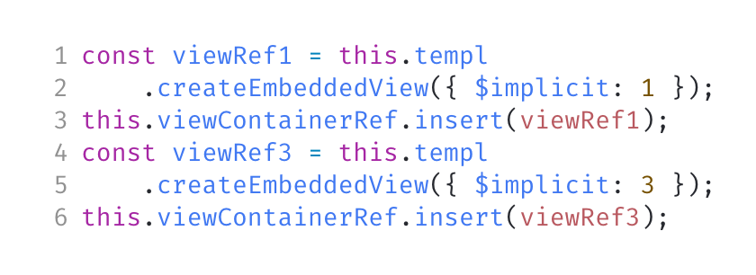
View Reference Fun
Demo
Demo
Angular uses views because it can't do the following:
Can't move elements
Can't change # of elements
But, views have APIs for the following:
Can move template
Can insert template
Similar to Angular's code
No, this is not the "Angular source" I was talking about in the talk bio

Slide 10
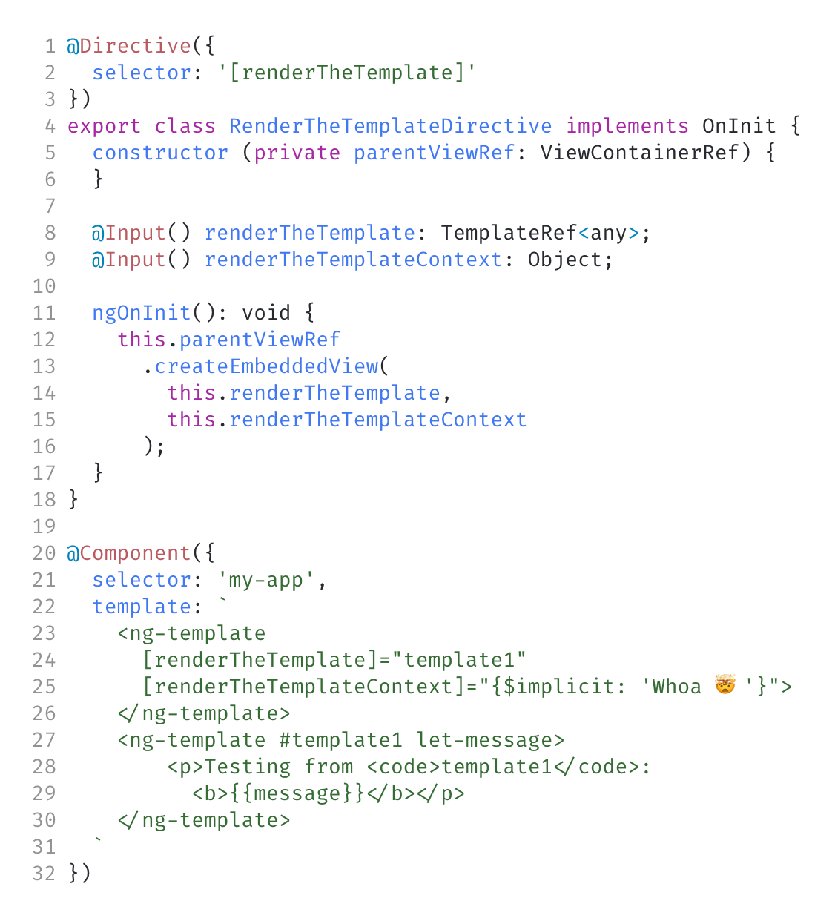
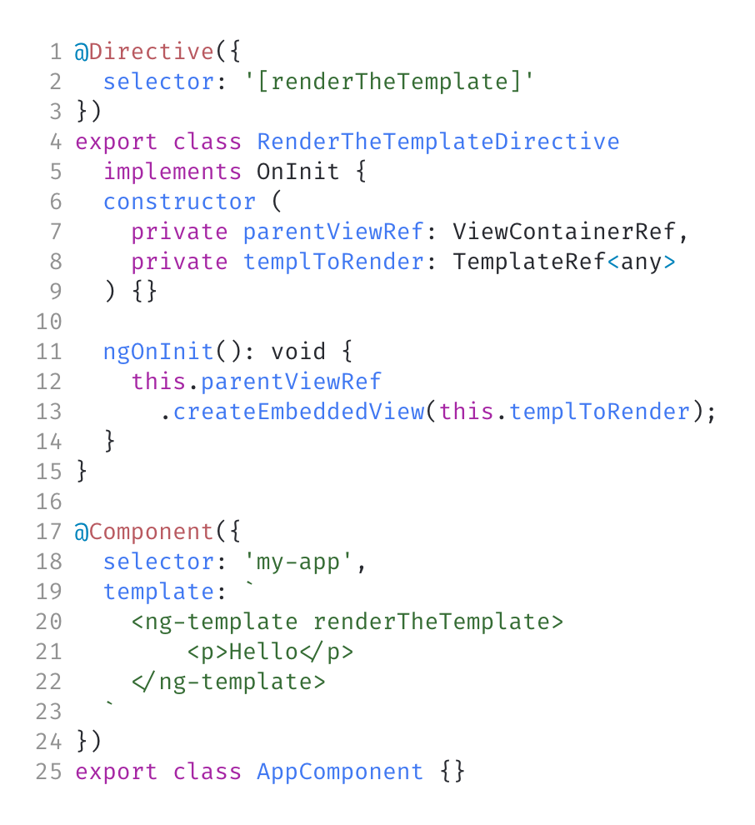
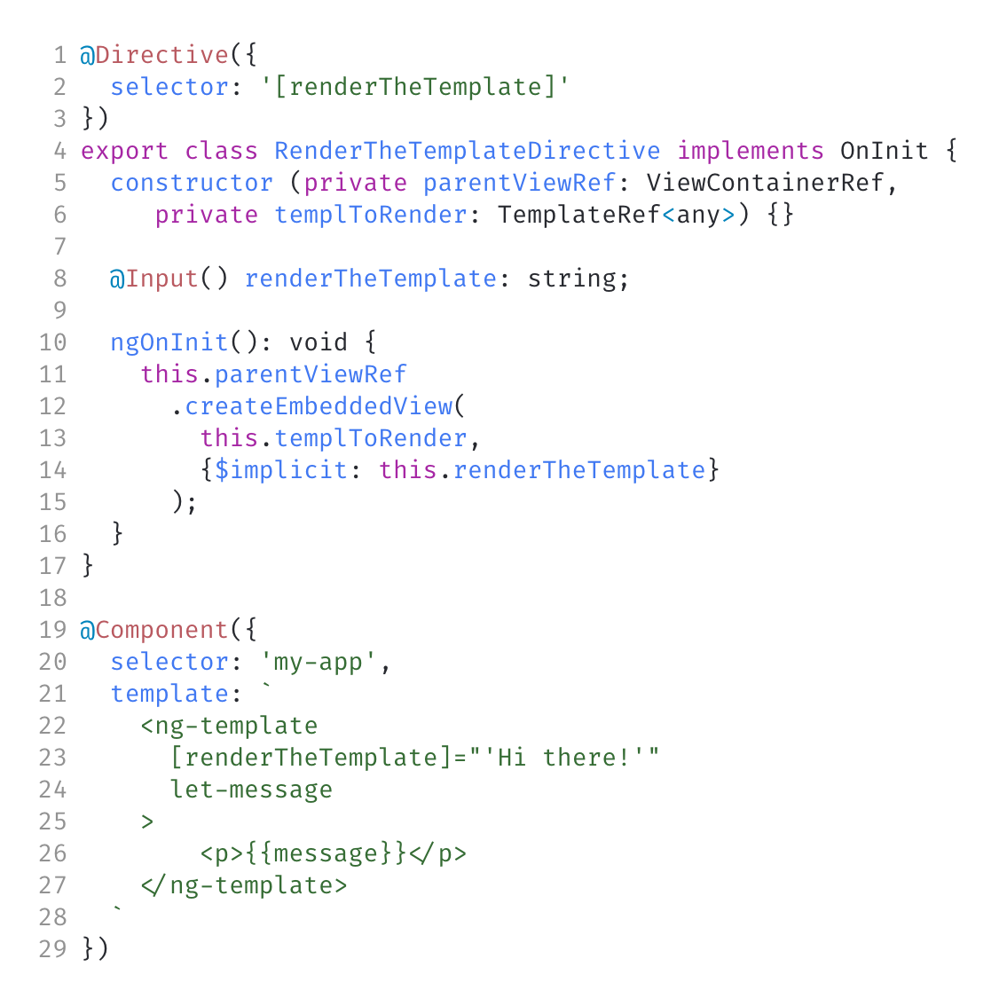
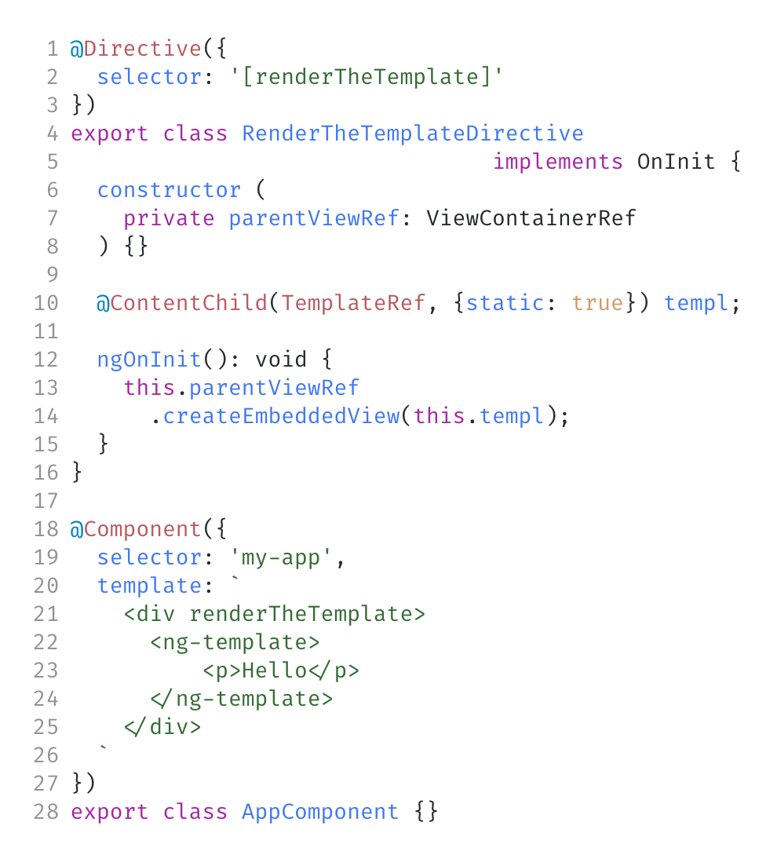
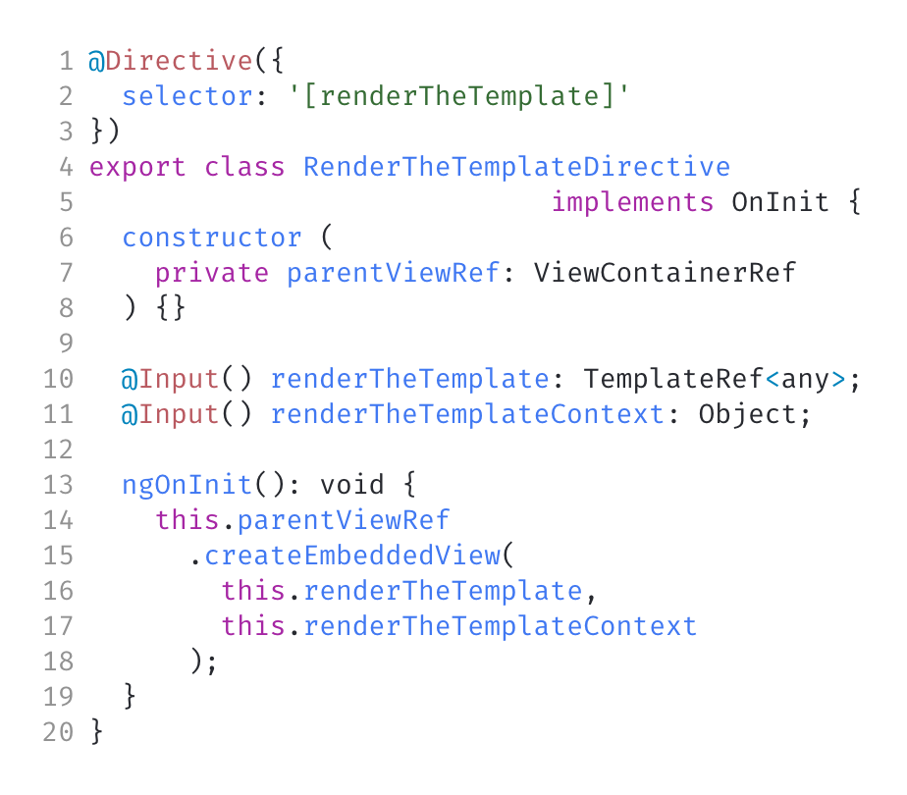
Templates From Directives
Demo
Demo
Demo
Demo
You can do the same template manipulations directly from a directive
Create templates
Create a view container from a directive
Angular creates them on request invisibly
Can get reference to element/template from the directive
Let's go look at how Angular did it

Slide 11
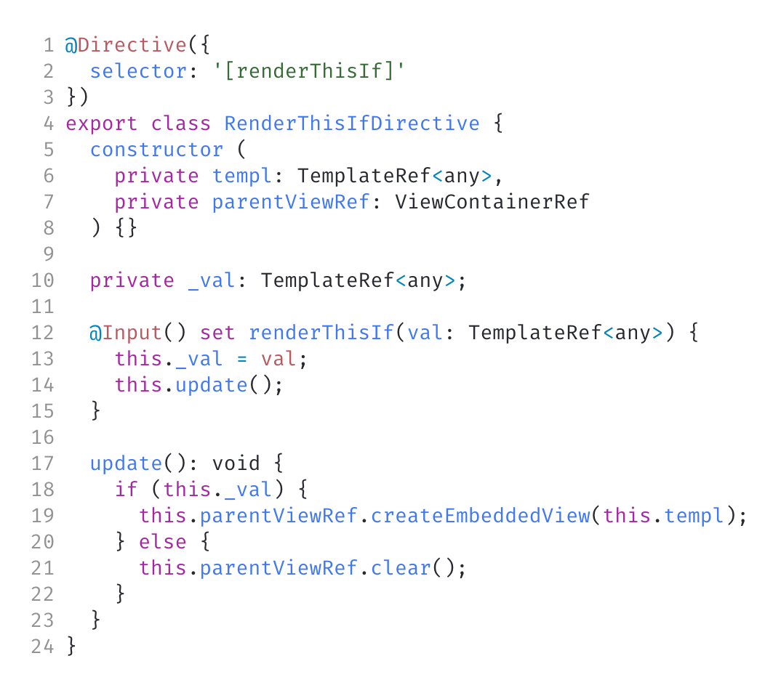
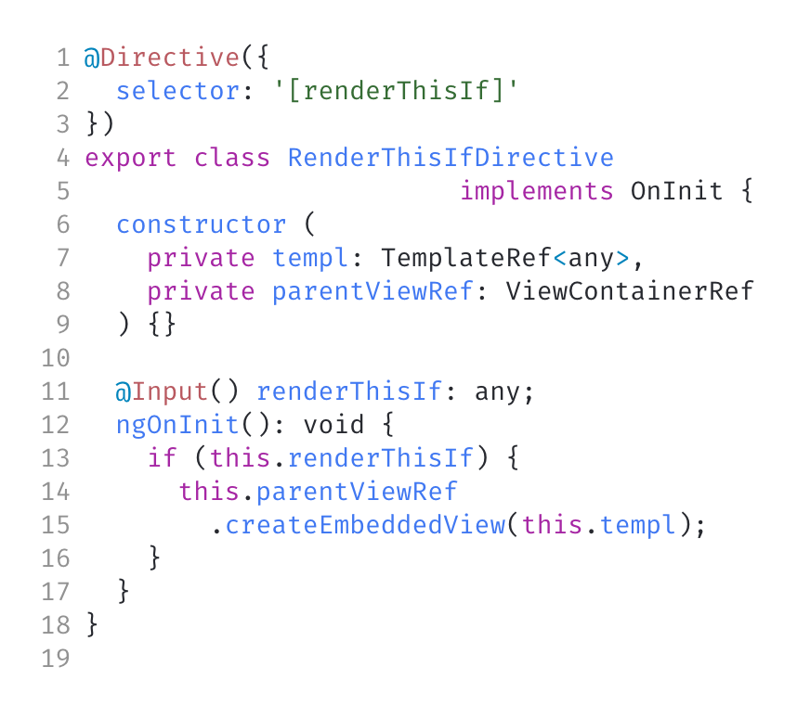
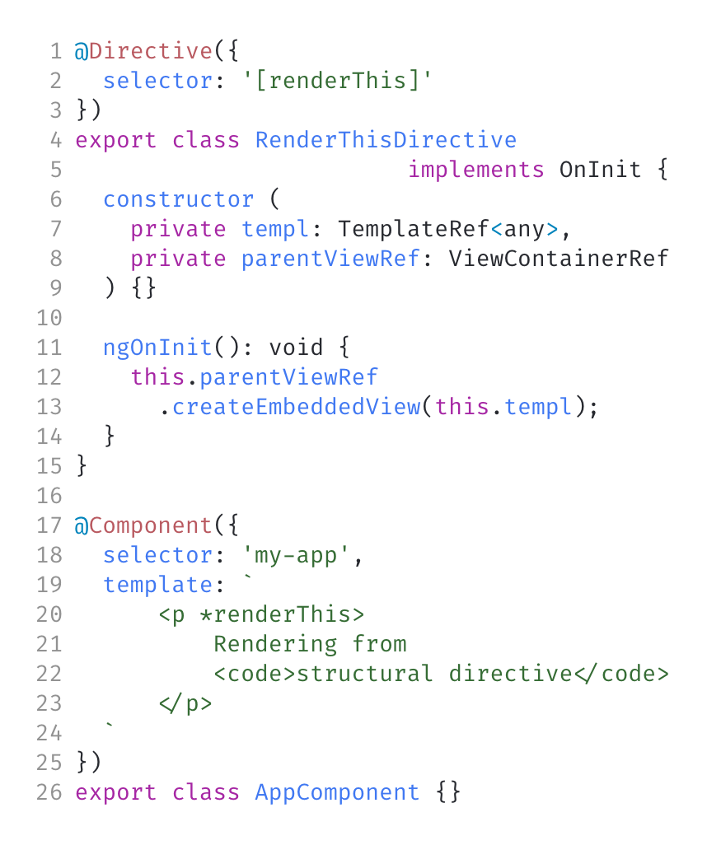
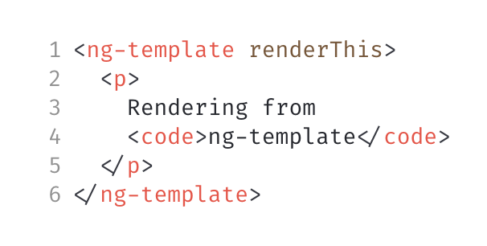
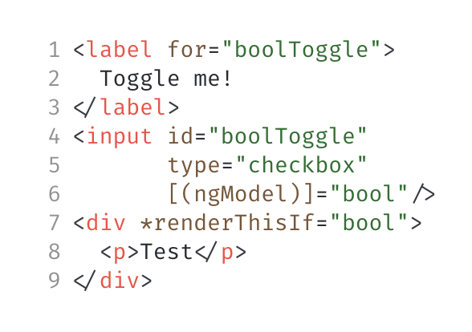
Structural Directives
Demo
Demo
Demo
A shorthand way to wrap a tag in a template
Highly extensible
Extremely shorthand
Supports all of the same directive code
Can be applied as a normal directive
Once again - let's go check the source code

Slide 12
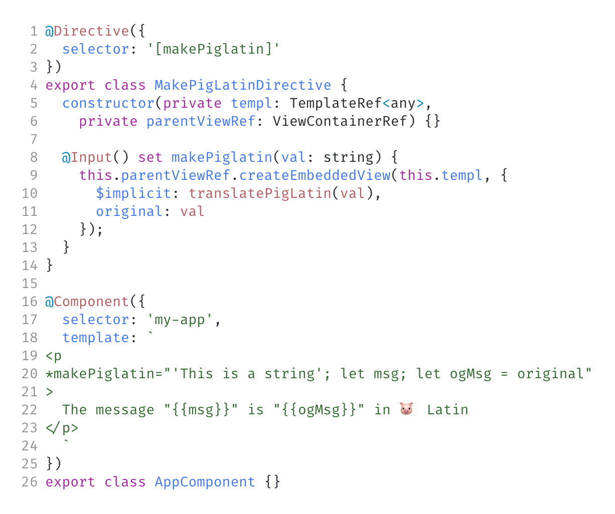
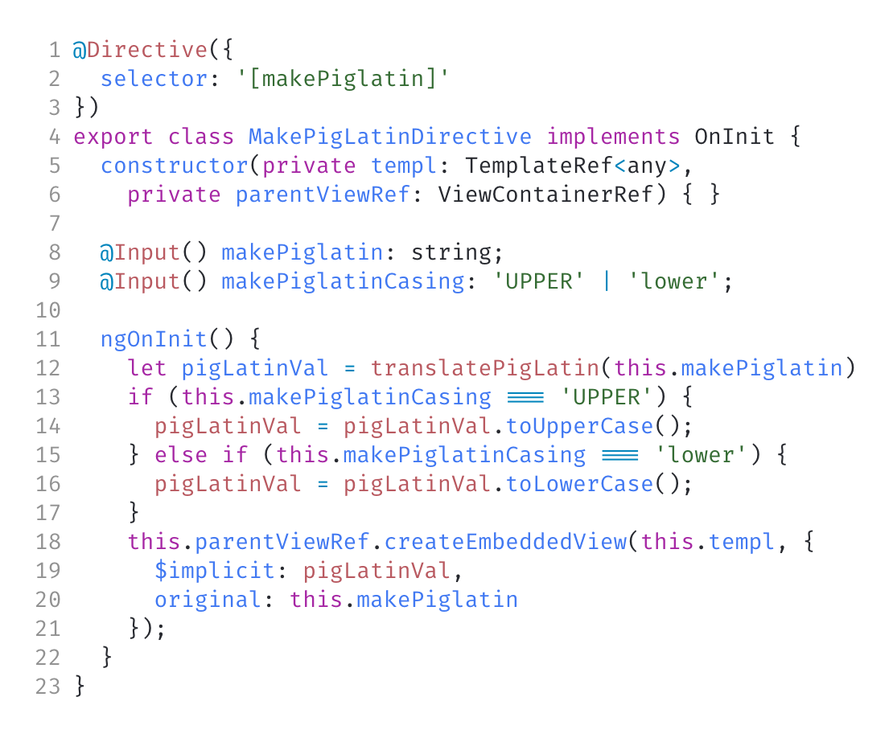
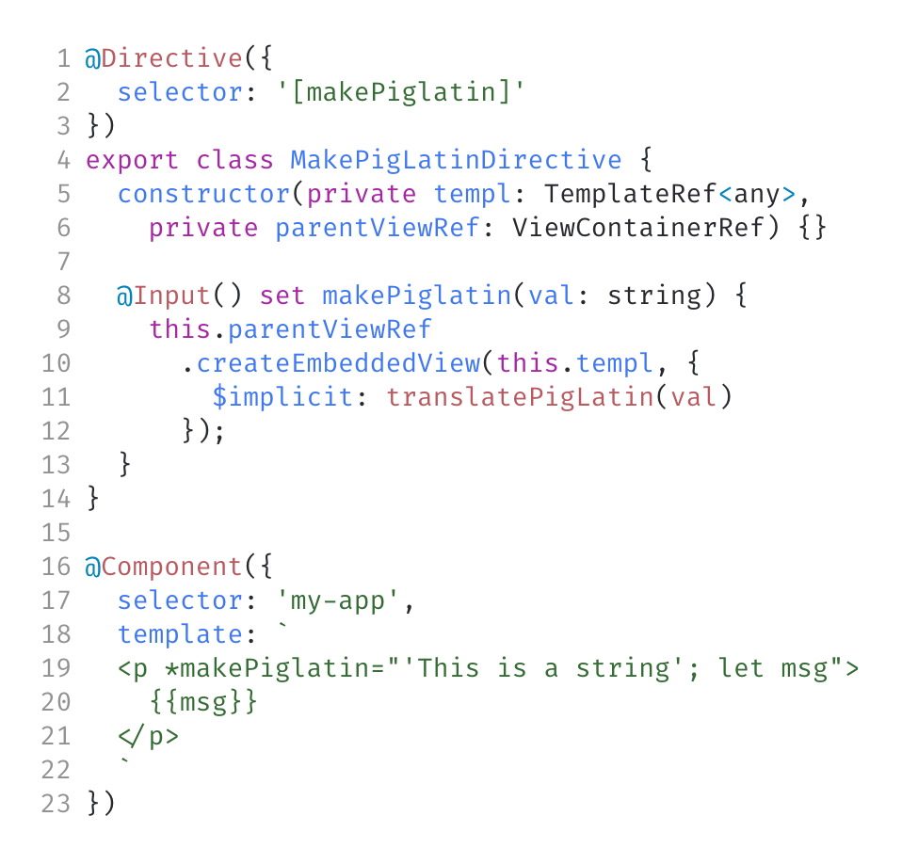
MicroSyntax
Demo
Demo
Demo
Structural directives have a special language-like syntax to bind to context and inputs
Inputs
Default context binding
Named context binding
Multi-inputs

Slide 13
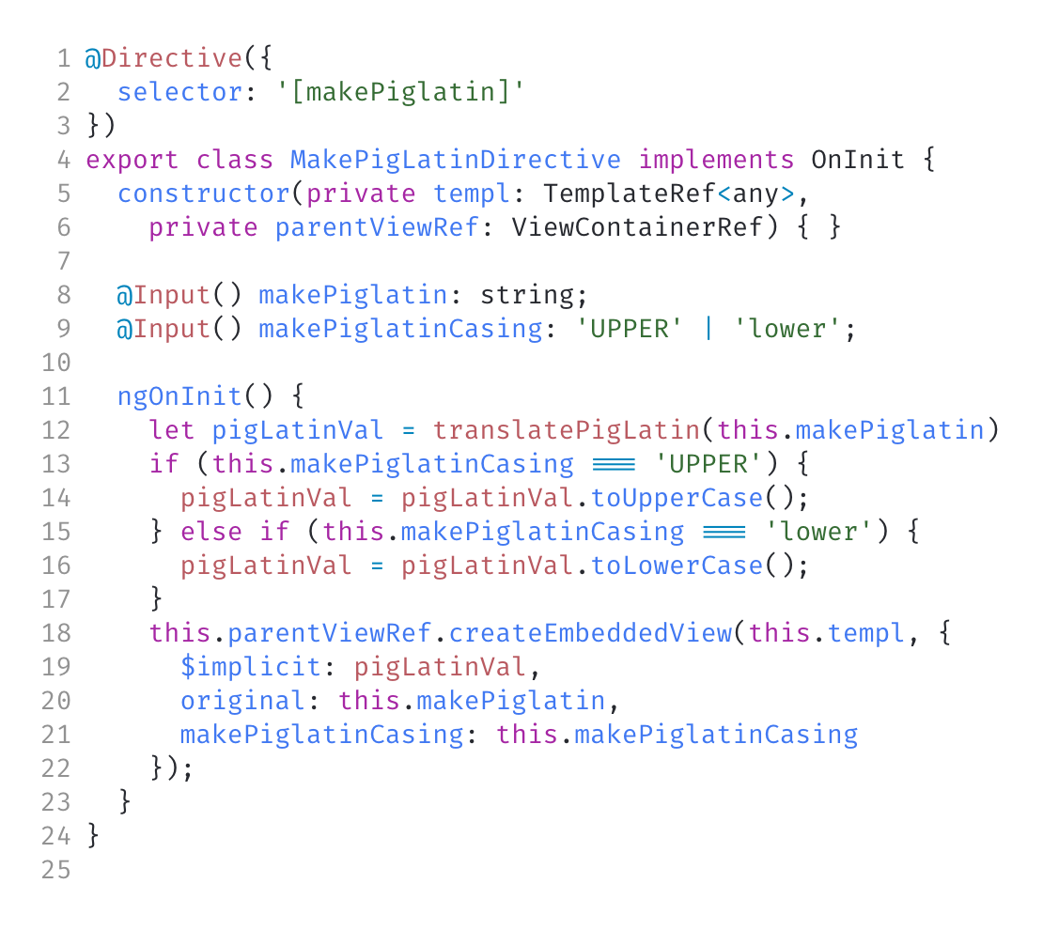
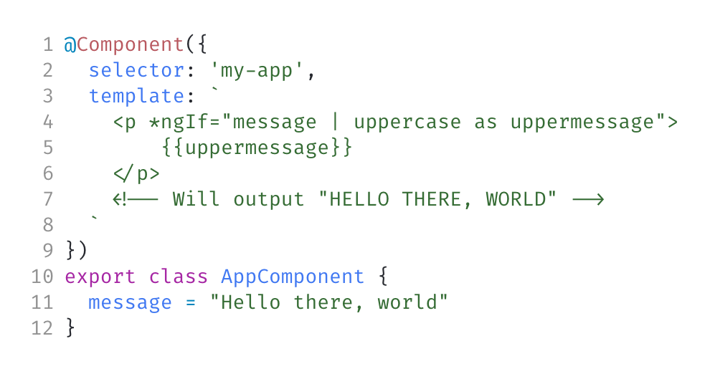
"As" keyword
Demo
Demo
The `as` keyword allows you to save an exported value as a reference variable
Works as an alternative to let keyword
Can be used to get a value from an input
Must return the same name of that input as context key

Slide 14
Dynamic Syntax
First value preserved for default input value
All separators are optional

Slide 15
MICROSYNTAX RULES
Key:
as
expression
export
as
local
;
expression
:as = :export "as" :local ";"?
Because of how loose the syntax is for microsyntax, you can keep this handy quisy-regex handy in mind to know what's a valid syntax: `*:prefix="( ("let" :local ("=" :export)? ";"?) | (:expression ("as" :local)?) ) (';' | ',')? ( ("let" :local ("=" :export)? ";"?) | (:export "as" :local ";"?) | (:key ":"? :expression ("as" :local)? ";"?) )*"` (yes, this is real, albeit expanded)
Microsyntax is based off of 4 main components
Expressions returns values to be passed to inputs
If no export var declared, assume default
keyExp
key
:
expression
as
local
;
:keyExp = :key ":"? :expression ("as" :local)? ";"?
let
A value or function call that returns a value
Input on directive with same name after prefix name
let
local
=
export
;
Optional Token
Preserved Keyword
Exported Key of Context
:let = "let" :local ("=" :export)? ";"?
Grouping of optional items
Template Reference Variable Declaration

Slide 16
Key:
as
expression
export
as
local
;
expression
:as = :export "as" :local ";"?
keyExp
key
:
expression
as
local
;
:keyExp = :key ":"? :expression ("as" :local)? ";"?
let
let
local
=
export
;
:let = "let" :local ("=" :export)? ";"?
A value or function call that returns a value
Input on directive with same name after prefix name
Optional Token
Preserved Keyword
Exported Key of Context
Grouping of optional items
Template Reference Variable Declaration

Slide 17
MICROSYNTAX RULES (PT2)
Second and beyond
First Only
All keys are prefixed with the selector
First item in microsyntax dedicated to input binding
All seperator tokens are optional
let
expression
;
or
;
*
prefix
="
or
or
as
or
"
let
,
or
,
keyExp
Item in microsyntax after the first
Optional Separator Token
Reserved token
HTML Attribute Key
First item in microsyntax

Slide 18
That's MicroSyntax!

Slide 19
Now Let's Apply It

Slide 20
Let's Remake ngFor!
Ground rules:
Sample syntax:
*uniFor="let item of items; let firstItem = isFirst"
Don't update rendered array when value changes
Don't worry about cleanup
AKA don't do this in prod ;)
How well did Corbin program on stage? Let's find out!

Slide 21
Thanks For Coming
Angular templates have more to them:
I have a blog post that covers them much more in-depth.
unicorn-utterances.com
Questions? Comments? Reach out to me or come talk after @crutchcorn on twitter
crutchcorn@gmail.com

